Slide 1
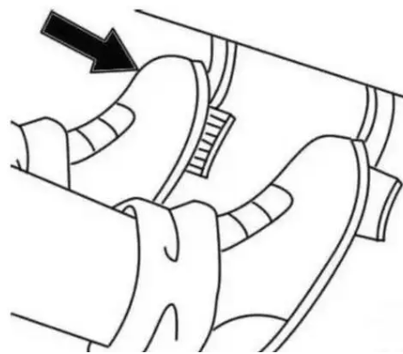

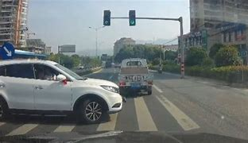



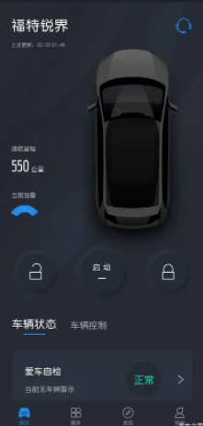
PCM-FD1
z
Depress brake pedal
Depress accelerator Pedal
Drive Video Record Feature Scope
ECG
Brake_Status
Veh_Speed
Integrated Dash Camera Module (IDCM)
Vehicle Battery System
Power Manager
LVDS
Serializer
Video Live View
Video Playback
DVR Status
Error Info
APIM
Setting Control
Manual Video/Photo via soft button / voice control
Video Playback Control
Data Copy & Deletion Control
Power Input
LVDS
FPD-Link
COAX
UART
Setting Change
Manual Video/Photo
TF Card Control
Status Synchronize
Watermark
Video Live View
Video Playback
Setting Display
Error Notification
Copy & Deletion Reminder
Recording Status Reminder
Windshield
IDC & AR
Camera
Video Input
TF Card
Manager
Data Copy
IDCM SWDL
Customer
eMMC
Legend:
G-Sensor
In Vehicle
Out Vehicle
Video Live View
Video Playback
DVR Data Copy
Ford APP
Account Login
Video Replay Control
DVR Data Copy Control
In IDCM
Wi-Fi
Wi-Fi
Manager
CAN
HMI
Exterior
Environment
Environment
LVDS Coax
Video Live View
Video Playback
Copy Status Reminder
Video
Power
Crash Detection

Slide 2
PCM-FD1
z
Drive Video Record Feature Scope
ECG
Legend:
Brake_Status
Veh_Speed
In Vehicle
Out Vehicle
Integrated Dash Camera Module (IDCM)
In IDCM
Wi-Fi
Vehicle Battery System
CAN
HMI
Video Live View
Video Playback
DVR Status
Error Info
Environment
LVDS Coax
Power Manager
LVDS
Serializer
Video
Power
APIM
Setting Control
Manual Video/Photo Control
(softbutton & voice control)
Video Playback Control
Data Copy & Deletion Control
Power Input
LVDS
FPD-Link
COAX
UART
Setting Change
Manual Video/Photo
TF Card Control
Status Synchronize
Watermark
Video Live View
Video Playback
Setting Display
Error Notification
Copy & Deletion Reminder
Recording Status Reminder
Windshield
IDC & AR
Camera
Video Input
TF Card
Manager
Data Copy
IDCM SWDL
Customer
eMMC
Exterior
Environment
G-Sensor
Crash Detect
Video Live View
Video Playback
DVR Data Copy
Ford APP
Account Login
Video Replay Control
DVR Data Copy Control
Wi-Fi
Manager
Video Live View
Video Playback
Copy Status Reminder

